Slide 1
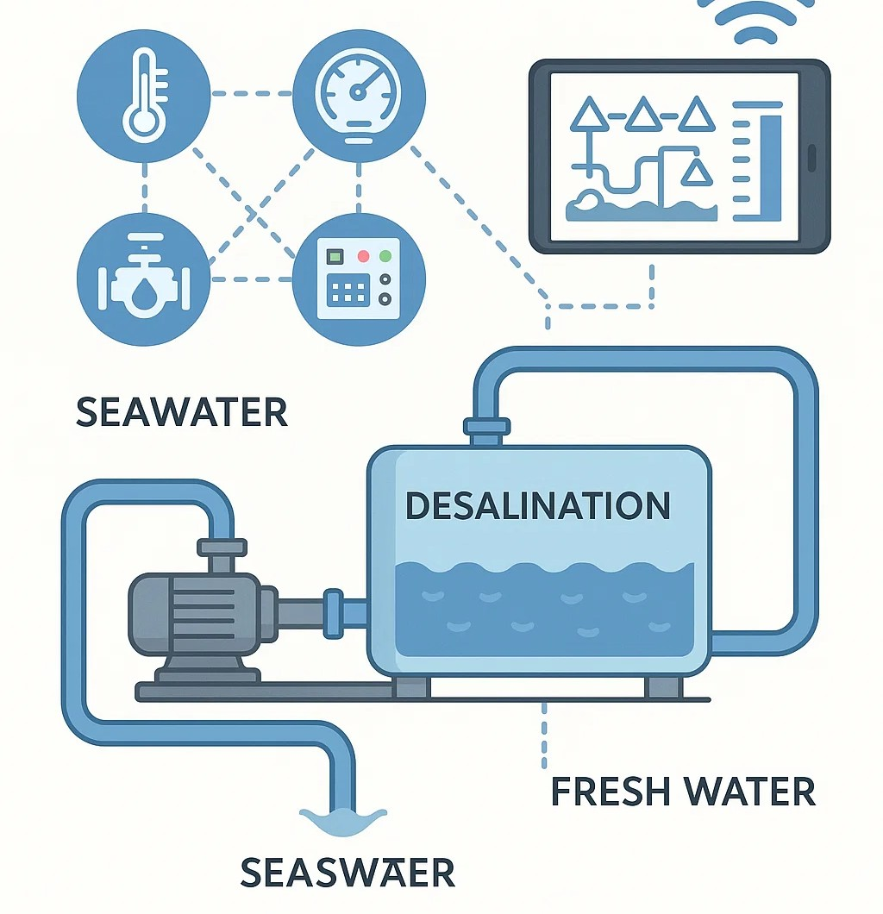
Smart Distributed Control System for Water Desalination Using SCADA, PLC, IoT, and AI Technologies
Presented by : Mahmoud Kamal Abu Aisha
Supervised by: Dr. Yousef E. Hamouda

Slide 2
Contents
Introduction
Related Work
Methodology
System Architecture
Future Scope
Conclusion
Proposed System
Results
References

Slide 3
Introduction
Water scarcity is a major global challenge, especially in arid regions. Desalination, particularly reverse osmosis (RO), offers a solution but is energy-intensive and complex to manage.
This project proposes a smart distributed control system integrating:
PLC for real-time process control
SCADA for centralized monitoring
IoT for sensor-based data collection
AI for predictive maintenance & optimization
The goal is to enhance efficiency, reduce costs, and enable autonomous water treatment in remote or resource-limited areas.

Slide 4
Related Work
[1] F. Alam, R. Mehmood, I. Katib, and A. Albeshri, “Intelligent process automation for industrial water treatment plants using AI and IoT”.
[2] M. M. Al-Sammarraie and R. A. Al-Azzawi, “PLC & SCADA based automation of industrial reverse osmosis desalination plants.
[3] S. N. S. Ismail, Z. Yusop, M. R. Othman, et al., “Performance evaluation of smart monitoring system in industrial-scale water treatment using AIoT”.
[4] A. M. Predescu, E. Matei, and L. Dumitrescu, “Smart water management using AI: A case study of membrane fouling detection in RO plants,” Journal of Water Reuse and Desalination, vol. 10, no. 3, pp. 302–315, 2020.
[5] A. Singh and A. Yadav, “Enhancing water supply systems with PLC and SCADA-based automation and AI integration,” Procedia Computer Science, vol. 230, pp. 1612–1620, 2024.
[6] M. Khatri, et al., “Smart AI-based real-time monitoring system for membrane integrity in RO plants,” Journal of Water Process Engineering, vol. 60, p. 104303, 2024.
[7] F. Alqahtani, et al., “Towards sustainable water treatment: SCADA-based control architecture with integrated AI models,” Discover Water, vol. 4, p. 10, 2024.
[8] T. M. Mansour and S. H. Mohamed, “SCADA-enabled distributed control for real-time water quality assurance in desalination plants,” Desalination and Water Treatment, vol. 289, pp. 143–152, 2023.
[9] A. S. A. Mohammed, M. A. Ahmed, M. E. Elkheir, and S. A. E. A. Habib, “A Review of Modern SCADA Security Threats and Countermeasures,” Heliyon, vol. 10, no. 1, p. e24058, Jan. 2024.
[10] M. Alam, R. Islam, and A. Almogren, “A Secure Data Transmission Framework for SCADA Systems Using Lightweight Encryption and MQTT Protocol,” IEEE Access, vol. 9, pp. 106115–106130, 2021.
[11] A. Umachagi, V. S. Anami, and S. S. Manvi, “PLC and SCADA based industrial automation in water treatment plant,” Materials Today: Proceedings, vol. 37, pp. 387–391, 2020.

Slide 5
Problem Statement
🔸 Identified Gap
Few studies fully integrate PLC, SCADA, IoT, and AI into one unified smart control system for desalination.
🔸 Contribution
This research proposes a scalable, intelligent control architecture to optimize operations, reduce failures, and support remote management of desalination plants.

Slide 6
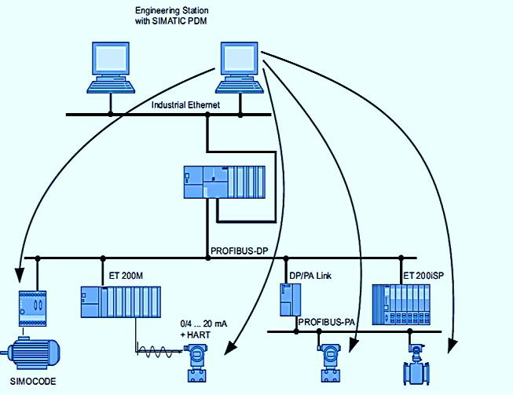
Proposed System
The proposed system is a smart distributed control architecture tailored for automating and optimizing Reverse Osmosis (RO) desalination plants. It integrates four major technologies: PLC, SCADA, IoT, and Artificial Intelligence (AI) to enable intelligent, real-time, and autonomous operation.
PLC Layer: Uses Siemens S7-300 or equivalent to control pumps, valves, and dosing systems through ladder logic in TIA Portal. Ensures precise and reliable execution of each treatment stage including pre-treatment and membrane flushing.
SCADA Layer: Acts as the supervisory interface, enabling real-time visualization, data acquisition, alarm generation, and performance logging. Operators can track key metrics such as pH, conductivity, flow rate, and membrane pressure using Modbus or PROFIBUS.
IoT Layer: Employs wireless protocols like LoRaWAN or Zigbee to connect sensors measuring turbidity, salinity, equipment vibration, and temperature. Supports remote diagnostics and monitoring, even in off-grid facilities.
AI Integration: Utilizes machine learning algorithms trained on historical plant data to perform predictive maintenance, detect early faults (e.g., membrane fouling), and dynamically optimize pump operations and energy usage. AI can operate at the edge or on cloud platforms.
This system enhances operational efficiency, reduces energy consumption, minimizes human intervention, and ensures water quality and resilience—especially in remote or resource-constrained environments

Slide 7
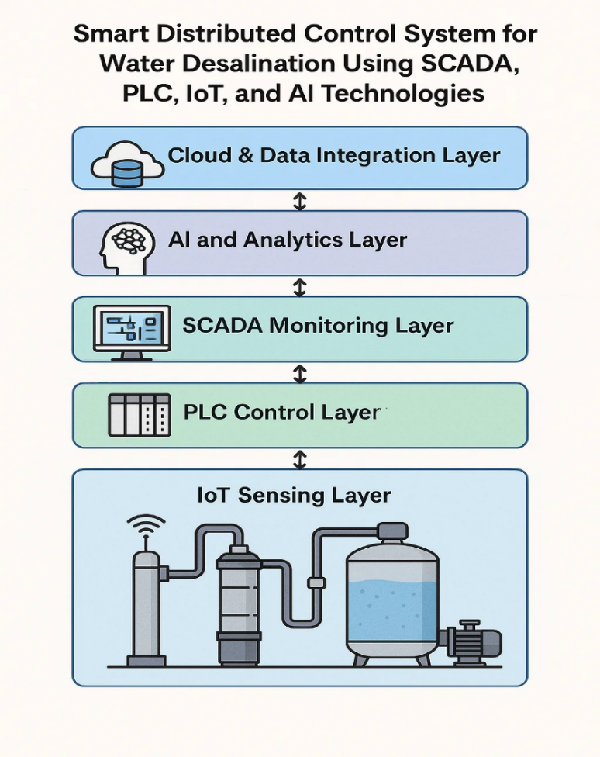
System Architecture
The proposed smart distributed control system adopts a modular, layered architecture optimized for water desalination, particularly in off-grid or decentralized environments. It comprises five integrated layers:
IoT Sensing Layer: Deploys smart sensors (pH, turbidity, salinity, flow, temperature) connected via LoRaWAN, Zigbee, or NB-IoT to collect real-time water quality data.
PLC Control Layer: Uses Siemens S7-300 or similar PLCs programmed in ladder logic to control pumps, valves, and dosing systems, ensuring fast and reliable actuation.
SCADA Monitoring Layer: Supervises system behavior through Modbus or PROFIBUS, offering real-time visualization, trend logging, alarms, and remote control via HMI.
AI & Analytics Layer: Implements machine learning models (e.g., ANN, SVM, RL) for predictive maintenance, anomaly detection, and dynamic energy optimization.
Cloud/Data Layer: Facilitates remote diagnostics and long-term analytics via secure MQTT/HTTPS protocols on cloud platforms like AWS or Azure.
This interconnected and scalable system ensures automation, energy efficiency, and intelligent decision-making—paving the way for smart water grid integration.

Slide 8
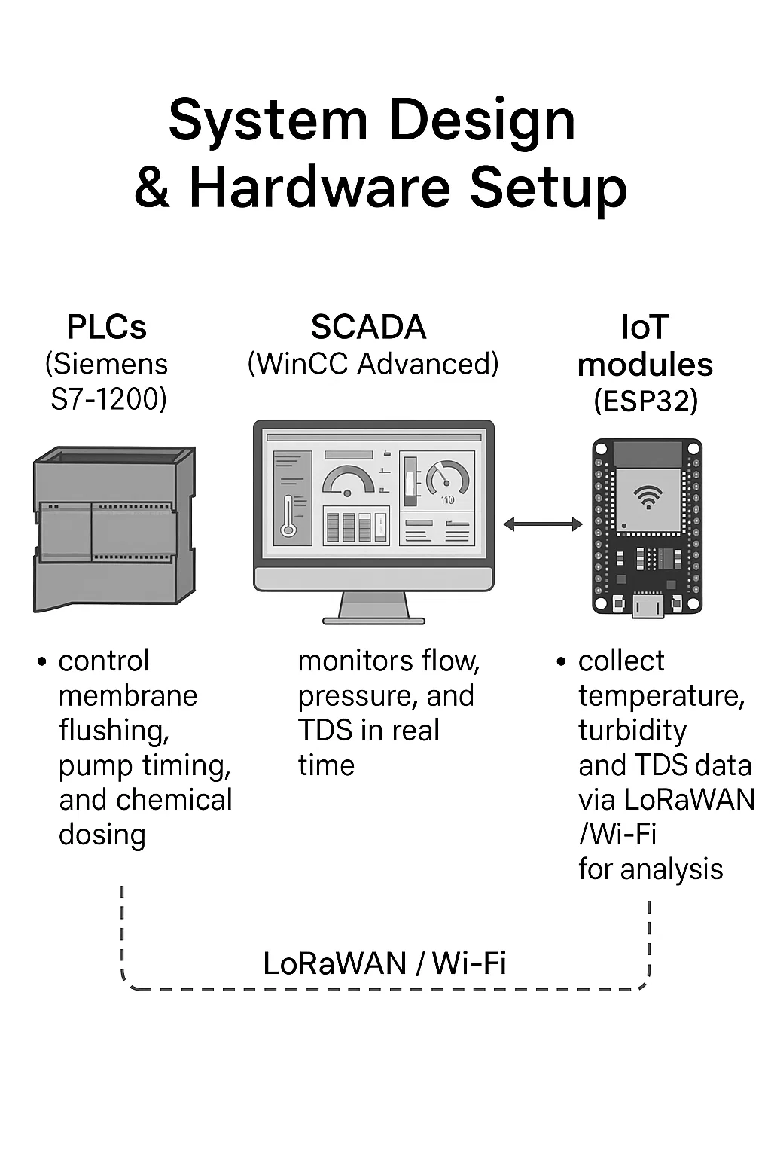
Methodology
This study adopts a design-based experimental methodology to develop a smart, distributed control system combining PLC, SCADA, IoT, and AI layers for reverse osmosis (RO) desalination. The process is divided into key phases :
System Design & Hardware Setup
PLCs (Siemens S7-1200) control membrane flushing, pump timing, and chemical dosing.
SCADA (WinCC Advanced) monitors flow, pressure, and TDS in real time.
IoT modules (ESP32) collect temperature, turbidity, and TDS data via LoRaWAN/Wi-Fi for analysis

Slide 9
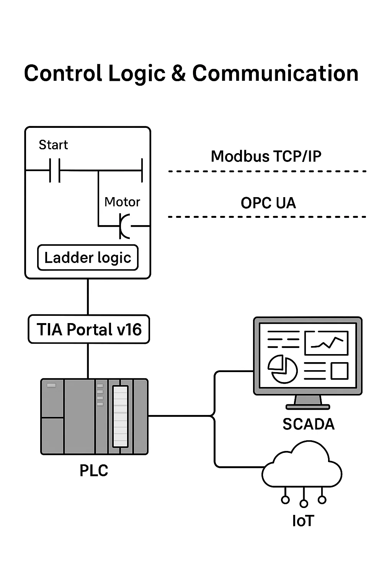
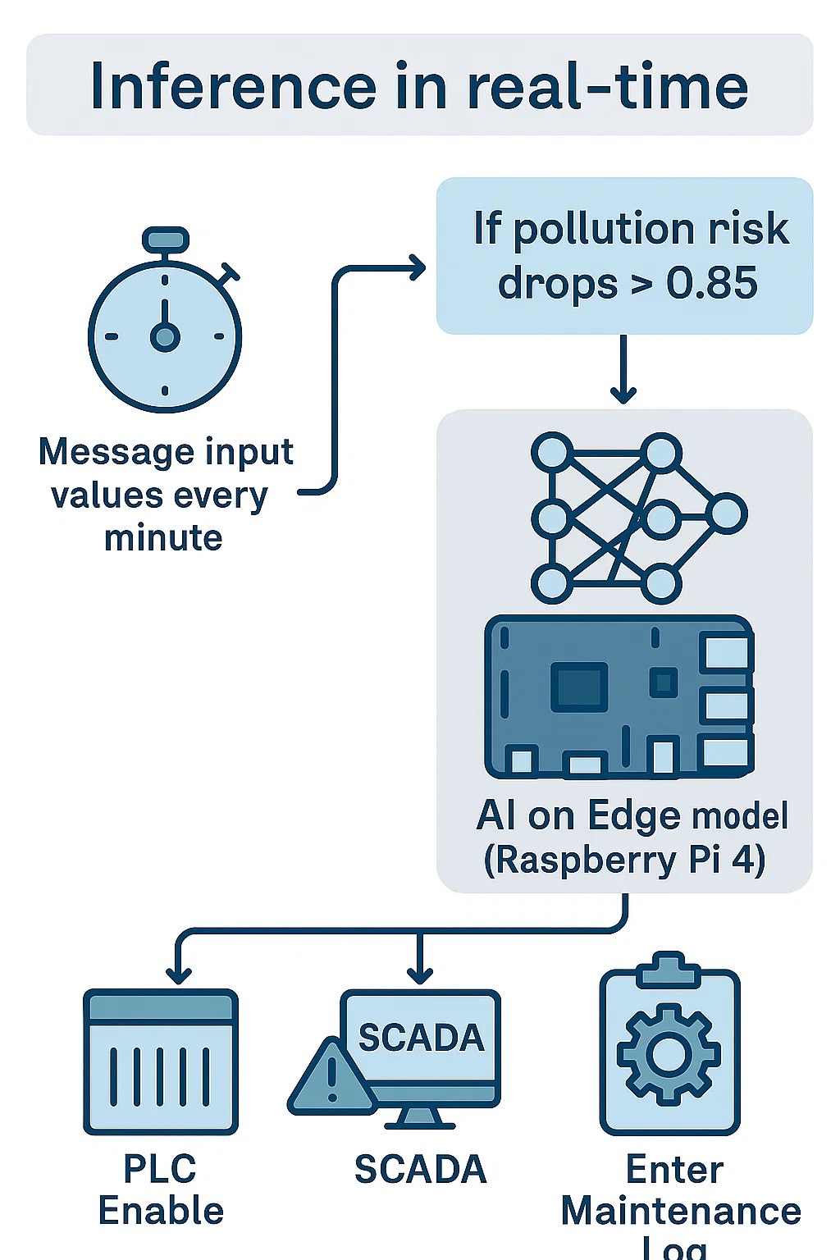
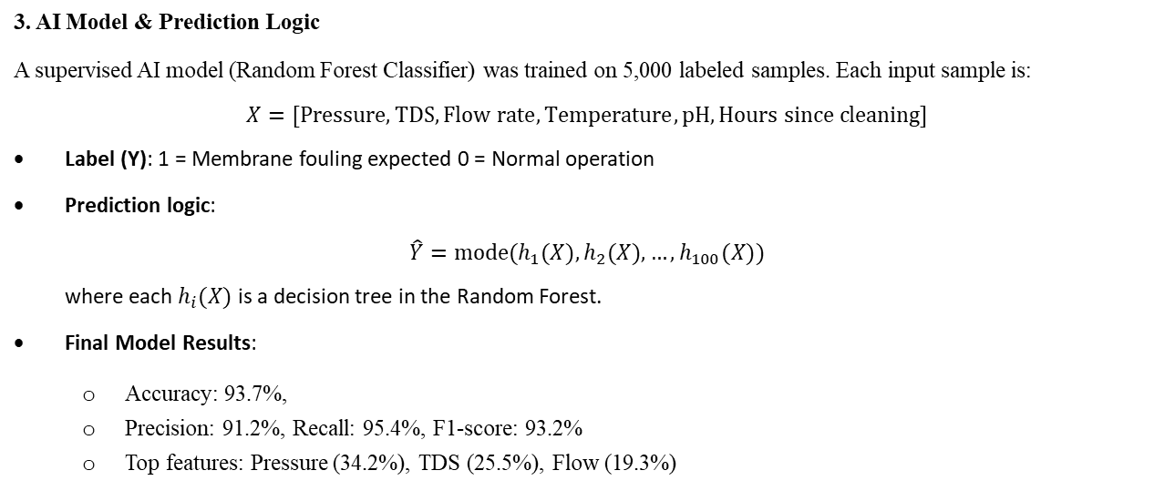
Methodology
2. Control Logic & Communication
Control logic is implemented in ladder logic using TIA Portal v16.
Modbus TCP/IP and OPC UA protocols handle real-time communication between PLC, SCADA, and IoT layers.
3. AI Model & Prediction Logic
A supervised AI model (Random Forest Classifier) was trained on 5,000 labeled samples. Each input sample is:
$$X=[Pressure,TDS,Flow rate,Temperature,pH,Hours since cleaning]$$
Label (Y): 1 = Membrane fouling expected 0 = Normal operation
Prediction logic:
$$\hat{Y}=mode(h_{1}(X),h_{2}(X),…,h_{100}(X))$$
where each $h_{i}(X)$ is a decision tree in the Random Forest.
Final Model Results:
Accuracy: 93.7%,
Precision: 91.2%, Recall: 95.4%, F1-score: 93.2%
Top features: Pressure (34.2%), TDS (25.5%), Flow (19.3%)

Slide 10
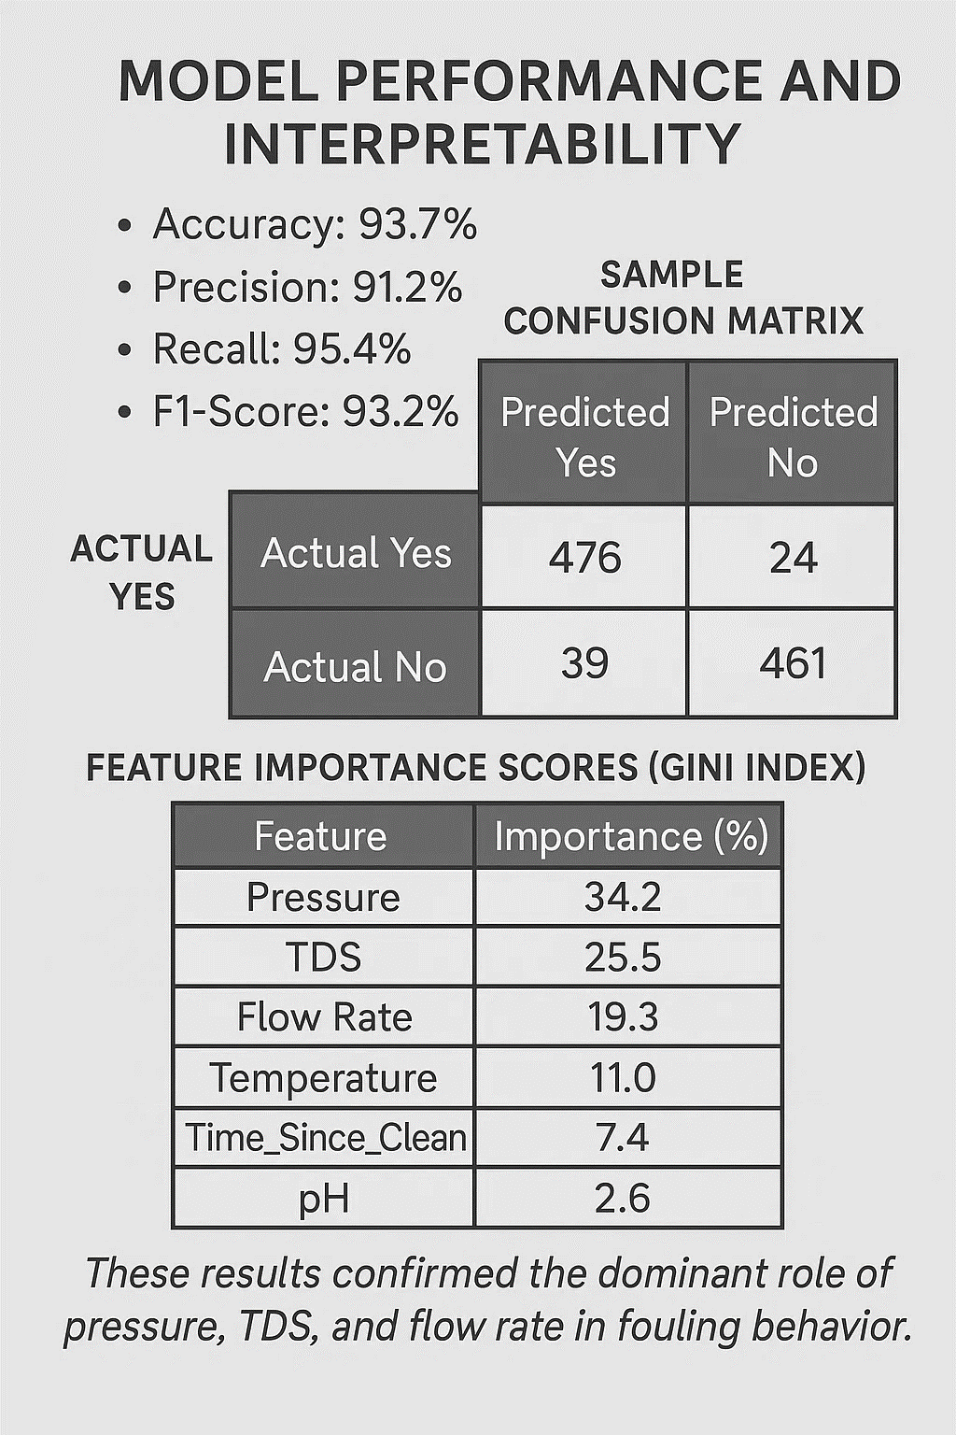
Methodology
4. Model Performance and Interpretability.

Slide 11
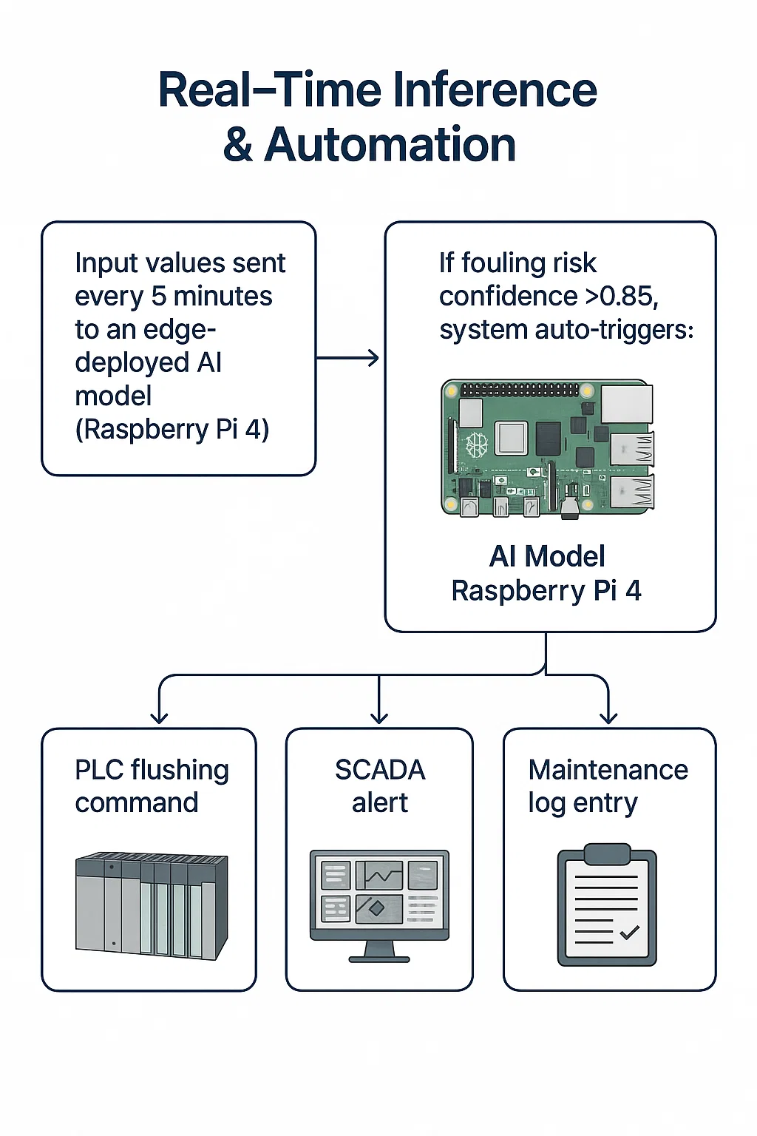
Methodology
5. Real-Time Inference & Automation
Input values sent every 5 minutes to an edge-deployed AI model (Raspberry Pi 4).
If fouling risk confidence > 0.85, system auto-triggers:
PLC flushing command
SCADA alert
Maintenance log entry

Slide 12
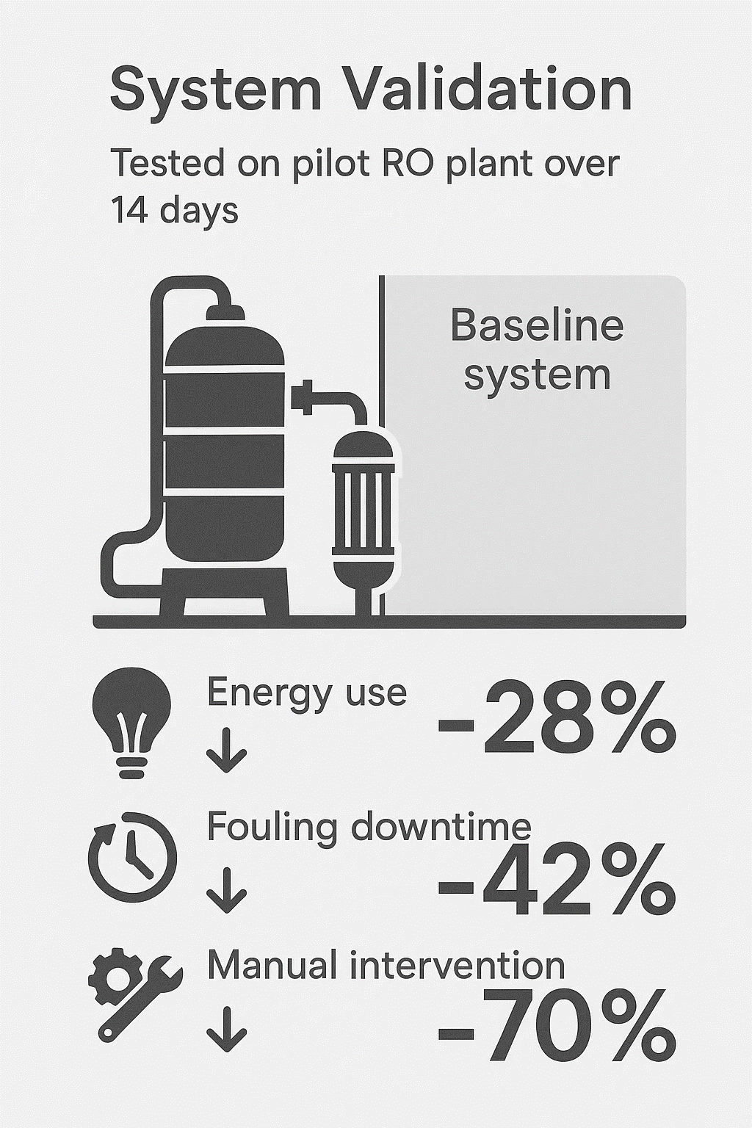
Methodology
6. System Validation
Tested on pilot RO plant over 14 days.
Compared to baseline system:
Energy use ↓ 28%
Fouling downtime ↓ 42%
Manual intervention ↓ 70%
7. Dataset & Sensor Calibration
Real data + open datasets (From SWaT).
Labeling based on maintenance logs and lab-validated reports.
Used SMOTE to balance dataset.
.8 Security & Reliability
TLS/SSL for MQTT, RBAC in SCADA.
Redundant sensors + watchdog timers.
Network segmentation and fail-safe logic ensure system robustness.
Future: IDS and blockchain logging for security.

Slide 13
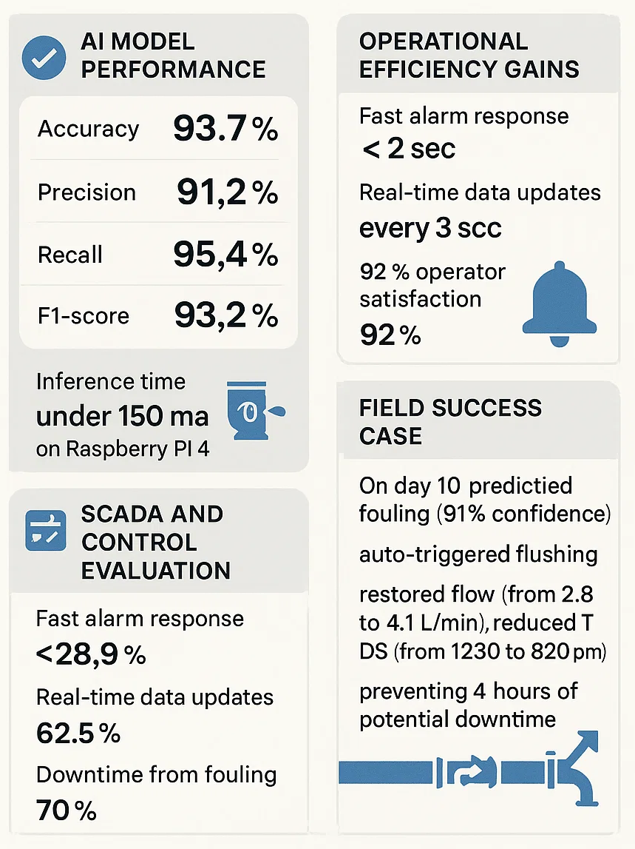
Results
The implementation of the smart distributed control system showed major improvements in three areas:
AI Model Performance: The Random Forest model achieved 93.7% accuracy, 91.2% precision, 95.4% recall, and 93.2% F1-score, with inference time under 150 ms on a Raspberry Pi 4. The low false negative rate is crucial for timely fouling preventi.
Operational Efficiency Gains: Compared to a rule-based system over 14 days, the AI system reduced:
Energy use per m³ by 28.9% (from 3.8 to 2.7 kWh)
Unnecessary cleanings by 62.5%
Downtime from fouling by 70%
Manual interventions by 70.6%
SCADA and Control Evaluation: SCADA showed fast alarm response (<2 sec), real-time data updates (every 3 sec), and 92% operator satisfaction. Logs confirmed accurate alignment of AI predictions with control actions.
Field Success Case: On day 10, AI predicted fouling (91% confidence), auto-triggered flushing, and restored flow (from 2.8 to 4.1 L/min) while reducing TDS (from 1230 to 820 ppm), preventing 4 hours of potential downtime.
These findings confirm that AI integration significantly improves desalination plant efficiency, reliability, and autonomy.

Slide 14
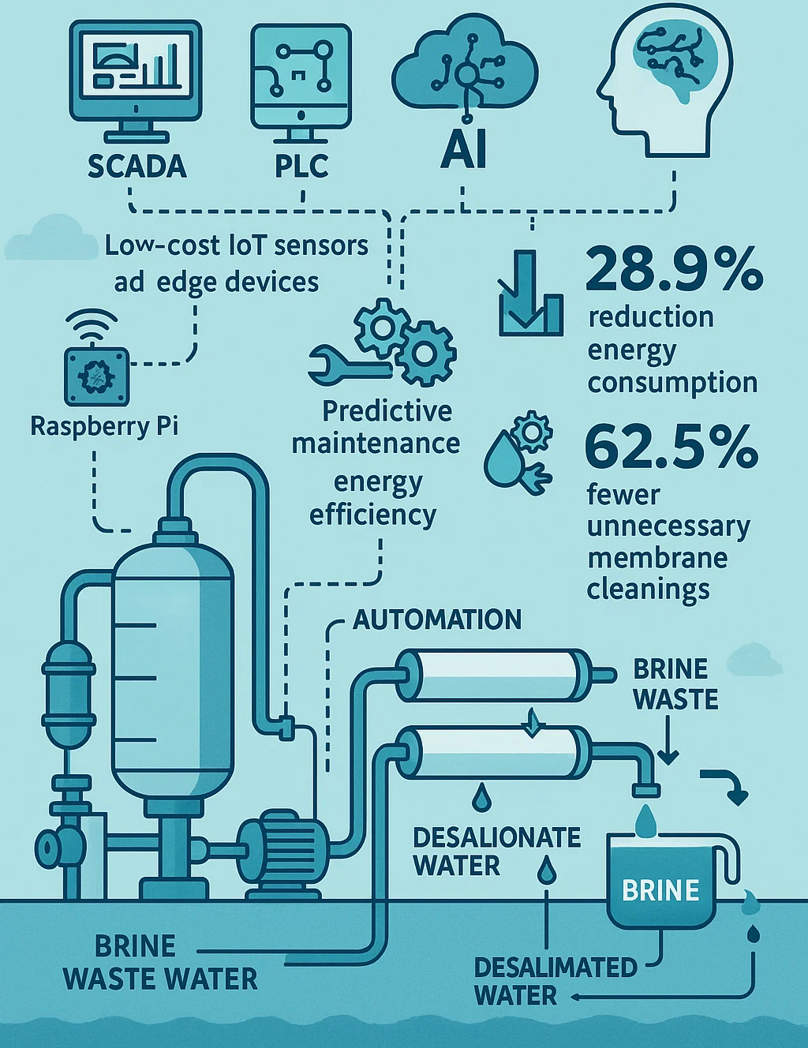
CONCLUSION
This research confirms the effectiveness of a Smart Distributed Control System for water desalination that integrates SCADA, PLC, IoT, and AI. By embedding machine learning into process control, the system enables predictive maintenance, energy efficiency, and greater automation.
Key results include:
28.9% reduction in energy consumption
62.5% fewer unnecessary membrane cleanings
Significant reduction in manual interventions
The use of low-cost IoT sensors and edge devices like Raspberry Pi demonstrates the system’s scalability and affordability for use in developing regions.

Slide 15
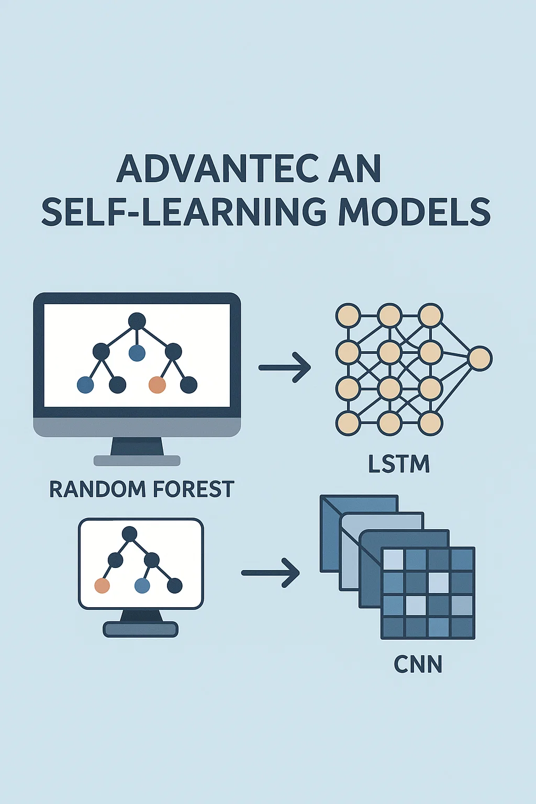
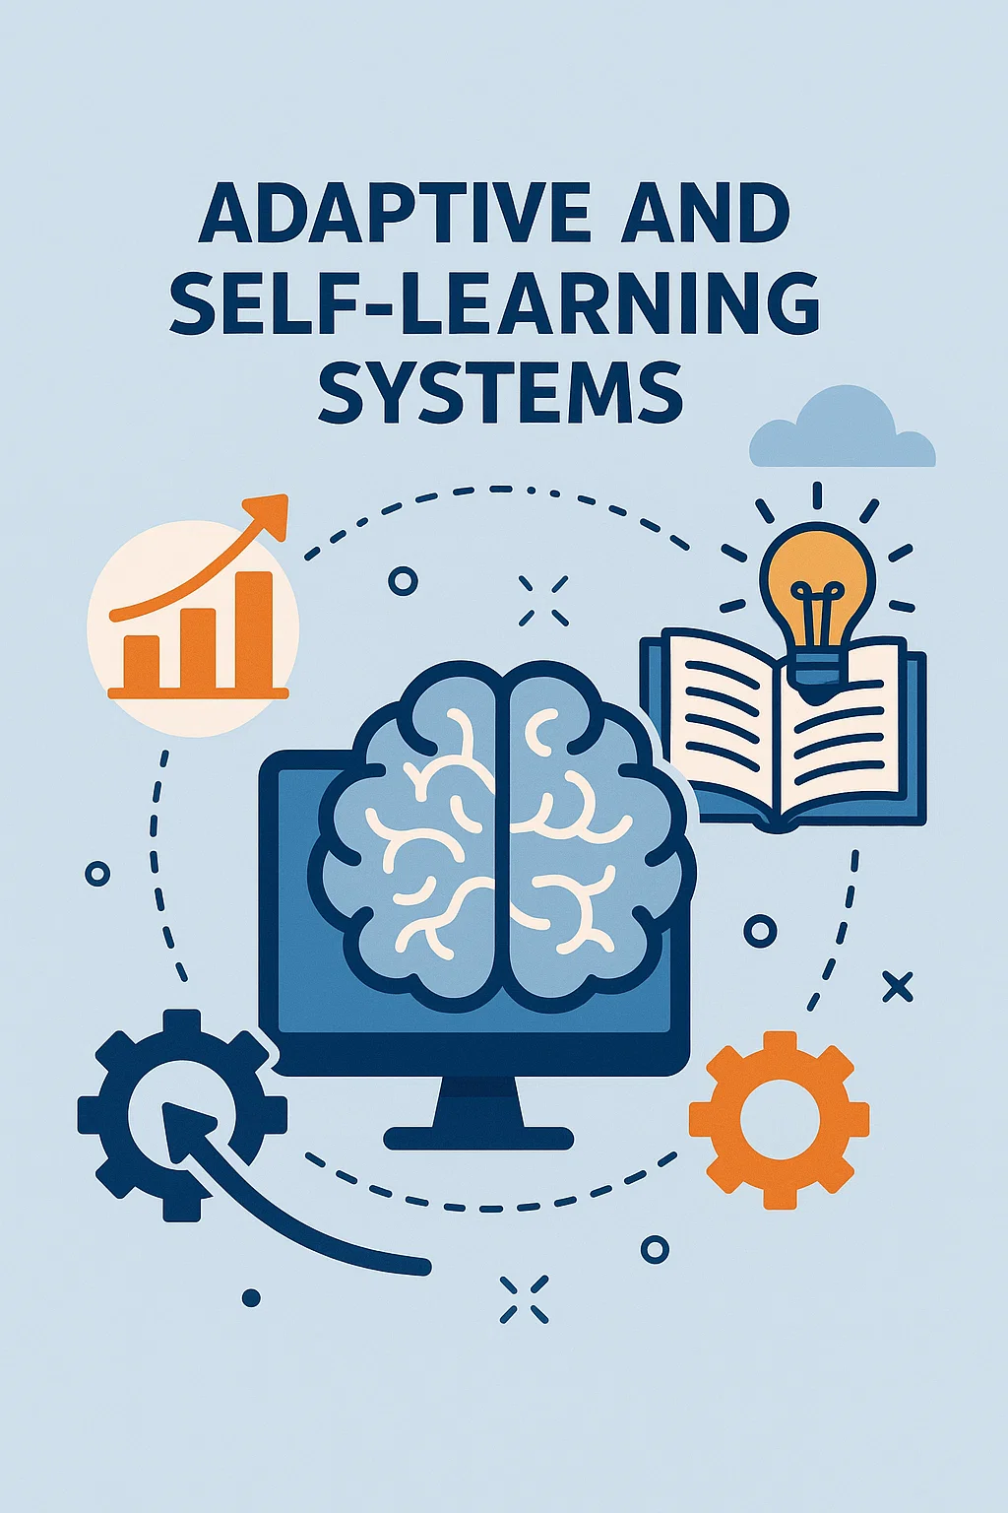

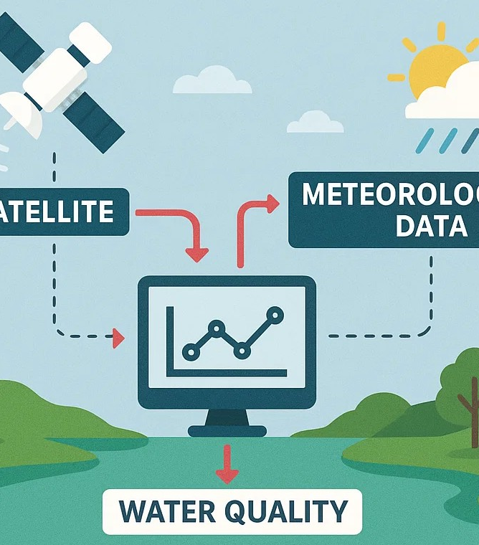
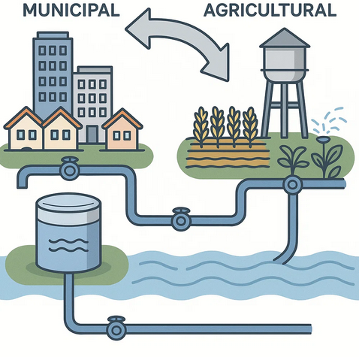
FUTURE SCOPE
Advanced AI and Deep Learning Models
Adaptive and Self-Learning Systems
Integration with Digital Twin Technology
Water Quality Forecasting Using Satellite and Meteorological Data
Scalability to Municipal and Agricultural Water Systems:

Slide 16
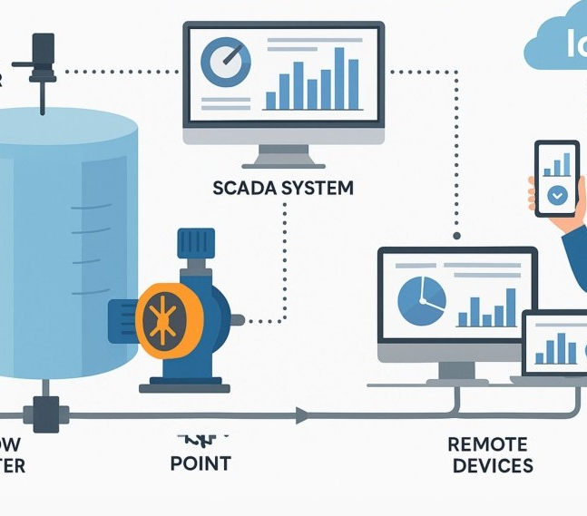


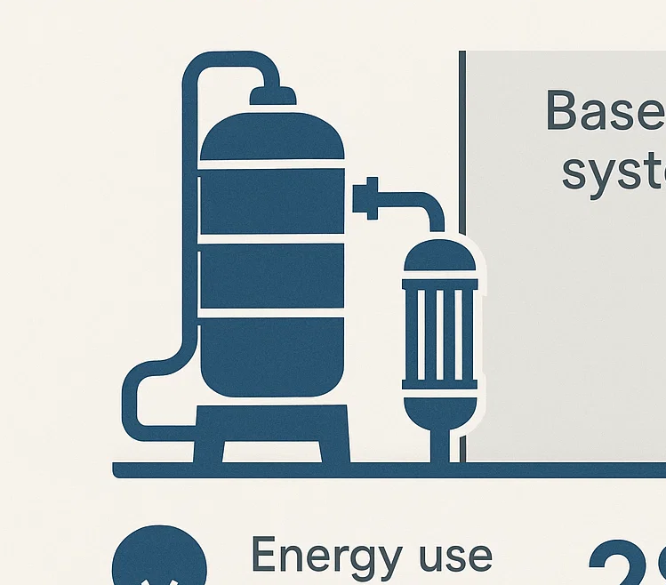
Thank you
Mahmoud Abu Aisha
mk.abuaisheh@std.alaqsa.edu.ps

